Slide 1

Chapter 10
Error Detection
and
Correction
10.<number>

Slide 2

Note
Data can be corrupted
during transmission.
Some applications require that
errors be detected and corrected.
10.<number>

Slide 3
10-1 INTRODUCTION
Let us first discuss some issues related, directly or indirectly, to error detection and correction.
Topics discussed in this section:
Types of Errors
Redundancy
10.<number>

Slide 4

Figure 10.1 Single-bit error
10.<number>

Slide 5

Figure 10.2 Burst error of length 8
10.<number>

Slide 6

Figure 10.3 The structure of encoder and decoder
To detect or correct errors, we need to send redundant bits
10.<number>

Slide 7

Figure 10.11 Two-dimensional parity-check code
10.<number>

Slide 8

Figure 10.11 Two-dimensional parity-check code
10.<number>

Slide 9

Figure 10.11 Two-dimensional parity-check code
10.<number>

Slide 10
10-4 CYCLIC CODES
Cyclic codes are special linear block codes with one extra property. In a cyclic code, if a codeword is cyclically shifted (rotated), the result is another codeword.
Topics discussed in this section:
Cyclic Redundancy Check
Hardware Implementation
Polynomials
Cyclic Code Analysis
Advantages of Cyclic Codes
Other Cyclic Codes
10.<number>

Slide 11
Cyclic Redundancy Checksum
The CRC error detection method treats the packet of data to be transmitted as a large polynomial.
The transmitter takes the message polynomial and using polynomial arithmetic, divides it by a given generating polynomial.
The quotient is discarded but the remainder is “attached” to the end of the message.
10.<number>

Slide 12
Cyclic Redundancy Checksum
The message (with the remainder) is transmitted to the receiver.
The receiver divides the message and remainder by the same generating polynomial.
If a remainder not equal to zero results, there was an error during transmission.
If a remainder of zero results, there was no error during transmission.
10.<number>

Slide 13
More Formally
M(x) - original message treated as a polynomial
To prepare for transmission:
Add r 0s to end of the message (where r = degree of generating polynomial)
Divide M(x)x^{r} by generating polynomial P(x) yielding a quotient and a remainder Q(x)+R(x)/P(x).
10.<number>

Slide 14
More Formally
Add (XOR) remainder R(x) to M(x)x^{r} giving M(x)x^{r}+R(x) and transmit.
Receiver receives message (M(x)x^{r}+R(x)) and divides by same P(x).
If remainder is 0, then there were no errors during transmission.
(Any expression which has exactly P(x) as a term is evenly divisible by P(x).)
10.<number>

Slide 15
Data word to be sent - 100100
Key - 1101
10.<number>

Slide 16
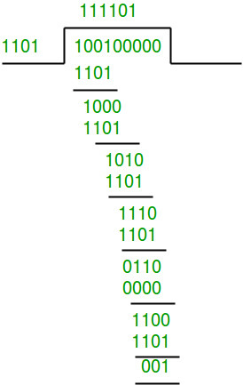
Sender Side
Therefore, the remainder is 001 and hence the encoded data sent is 100100001.
10.<number>

Slide 17
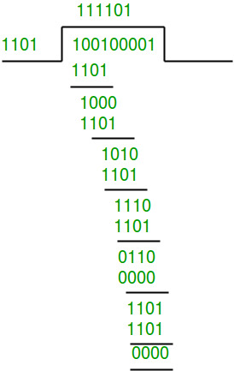
Receiver Side
Code word received at the receiver side 100100001
Therefore, the remainder is all zeros. Hence, the
data received has no error
10.<number>

Slide 18
Error in transmission
Sender’s Side
Data word to be sent - 100100
Key - 1101
Therefore, the remainder is 001 and hence the
code word sent is 100100001.
10.<number>

Slide 19
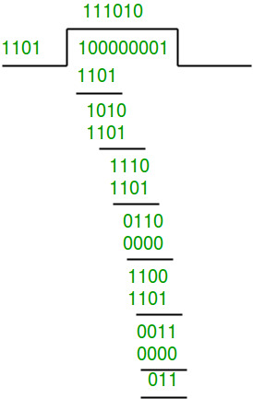
Receiver’s Side
Let there be error in transmission media
Code word received at the receiver side - 100000001
Since the remainder is not all zeroes, the error is detected at the receiver side.
10.<number>

Slide 20
Common CRC Polynomials
CRC-12: x¹² + x¹¹ + x³ + x² + x + 1
CRC-16: x¹⁶ + x¹⁵ + x² + 1
CRC-CCITT: x¹⁶ + x¹⁵ + x⁵ + 1
CRC-32: x³² + x²⁶ + x²³ + x²² + x¹⁶ + x¹² + x¹¹ + x¹⁰ + x⁸ + x⁷ + x⁵ + x⁴ + x² + x + 1
ATM CRC: x⁸ + x² + x + 1
10.<number>

Slide 21
CRC Example
Given a pretend P(x) = x⁵ + x⁴ + x² + 1 and a message M(x) = 1010011010, calculate the remainder using long hand division and a shift register.
10.<number>

Slide 22
10-5 CHECKSUM
The last error detection method we discuss here is called the checksum, or arithmetic checksum. The checksum is used in the Internet by several protocols although not at the data link layer. However, we briefly discuss it here to complete our discussion on error checking
Topics discussed in this section:
Idea
One’s Complement
Internet Checksum
10.<number>

Slide 23
Example 10.18
Suppose our data is a list of five 4-bit numbers that we want to send to a destination. In addition to sending these numbers, we send the sum of the numbers. For example, if the set of numbers is (7, 11, 12, 0, 6), we send (7, 11, 12, 0, 6, 36), where 36 is the sum of the original numbers. The receiver adds the five numbers and compares the result with the sum. If the two are the same, the receiver assumes no error, accepts the five numbers, and discards the sum. Otherwise, there is an error somewhere and the data are not accepted.
10.<number>

Slide 24
Example 10.19
We can make the job of the receiver easier if we send the negative (complement) of the sum, called the checksum. In this case, we send (7, 11, 12, 0, 6, −36). The receiver can add all the numbers received (including the checksum). If the result is 0, it assumes no error; otherwise, there is an error.
10.<number>

Slide 25
Example 10.20
How can we represent the number 21 in one’s complement arithmetic using only four bits?
Solution
The number 21 in binary is 10101 (it needs five bits). We can wrap the leftmost bit and add it to the four rightmost bits. We have (0101 + 1) = 0110 or 6.
10.<number>

Slide 26
Example 10.21
How can we represent the number −6 in one’s complement arithmetic using only four bits?
Solution
In one’s complement arithmetic, the negative or complement of a number is found by inverting all bits. Positive 6 is 0110; negative 6 is 1001. If we consider only unsigned numbers, this is 9. In other words, the complement of 6 is 9. Another way to find the complement of a number in one’s complement arithmetic is to subtract the number from 2^{n} − 1 (16 − 1 in this case).
10.<number>

Slide 27
Example 10.22
Let us redo Exercise 10.19 using one’s complement arithmetic. Figure 10.24 shows the process at the sender and at the receiver. The sender initializes the checksum to 0 and adds all data items and the checksum (the checksum is considered as one data item and is shown in color). The result is 36. However, 36 cannot be expressed in 4 bits. The extra two bits are wrapped and added with the sum to create the wrapped sum value 6. In the figure, we have shown the details in binary. The sum is then complemented, resulting in the checksum value 9 (15 − 6 = 9). The sender now sends six data items to the receiver including the checksum 9.
10.<number>

Slide 28
Example 10.22 (continued)
The receiver follows the same procedure as the sender. It adds all data items (including the checksum); the result is 45. The sum is wrapped and becomes 15. The wrapped sum is complemented and becomes 0. Since the value of the checksum is 0, this means that the data is not corrupted. The receiver drops the checksum and keeps the other data items. If the checksum is not zero, the entire packet is dropped.
10.<number>

Slide 29

Figure 10.24 Example 10.22
1 1 1 1
0 0 0 0
1
10.<number>

Slide 30
Note
Sender site:
1. The message is divided into 16-bit words.
2. The value of the checksum word is set to 0.
3. All words including the checksum are
added using one’s complement addition.
4. The sum is complemented and becomes the
checksum.
5. The checksum is sent with the data.
10.<number>

Slide 31
Note
Receiver site:
1. The message (including checksum) is
divided into 16-bit words.
2. All words are added using one’s
complement addition.
3. The sum is complemented and becomes the
new checksum.
4. If the value of checksum is 0, the message
is accepted; otherwise, it is rejected.
10.<number>

Slide 32
Example 10.23
Let us calculate the checksum for a text of 8 characters (“Forouzan”). The text needs to be divided into 2-byte (16-bit) words. We use ASCII (see Appendix A) to change each byte to a 2-digit hexadecimal number. For example, F is represented as 0x46 and o is represented as 0x6F. Figure 10.25 shows how the checksum is calculated at the sender and receiver sites. In part a of the figure, the value of partial sum for the first column is 0x36. We keep the rightmost digit (6) and insert the leftmost digit (3) as the carry in the second column. The process is repeated for each column. Note that if there is any corruption, the checksum recalculated by the receiver is not all 0s. We leave this an exercise.
10.<number>

Slide 33

Figure 10.25 Example 10.23
F
F
F F F F
10.<number>

